Slide 1

CLOUD MIGRATION
Hi, I’m Shreyas B Rao, Intern at NTT Ltd. I am currently doing my second year Computer Science engineering in Jain University (FETJU). I am a Techie as well as an aspiring musician. Aim to be productive.
Shreyas B Rao
chechu301001@gmail.com
https://www.linkedin.com/in/shreyas-b-rao-360296206/

Slide 2
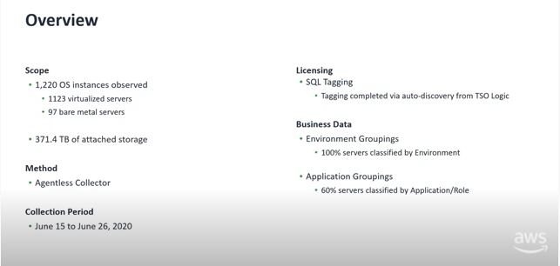
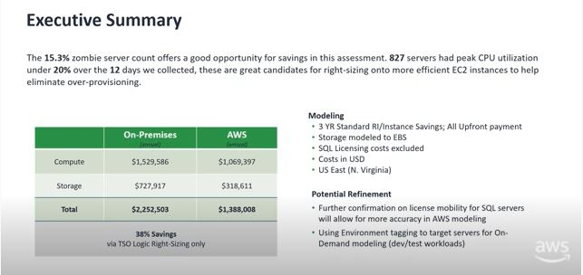
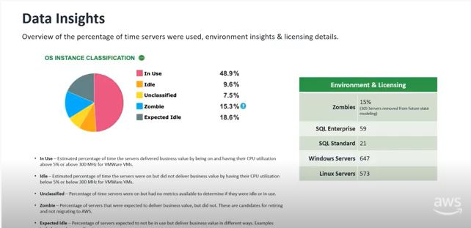
Prerequisites:
Problem: Private cloud having
30 Linux machines – 4vCPU, 8GB Memory
30 Windows machines – 8vCPU, 16GB Memory
Running on VMware with each machine having 100GB storage.
Aim to migrate to AWS
What went into the assessment (collection window, existing inventory from 3rd party export, assumptions, server counts)
an executive summary of the savings across a combination of scenarios applied to different workloads
a breakdown of what went into the on-premises costs
multiple workload specific 'what-if' scenarios for repurchasing and bring your own licenses
recommendation on next steps.
Migration Evaluator – TSO Logic
Migration Evaluator is a migration assessment service that helps you create a directional business case for AWS cloud planning and migration.

Slide 3
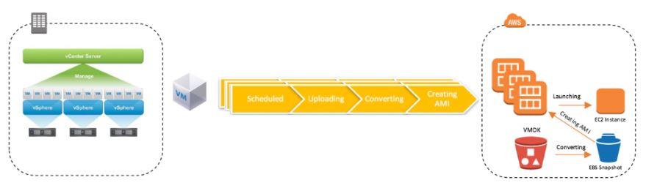
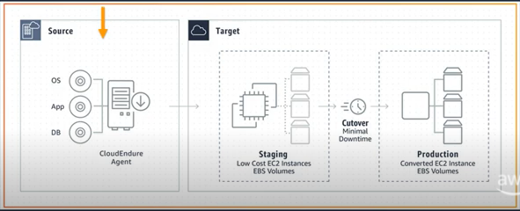
Solution:
Assumptions : Tools being used are approved by the customer. Customer is ready to opt for agentless or with agent tools. AWS is the preferred option by the customer and GCP is mentioned for comparison purposes.
Solution for this use case : CloudEndure
AWS Server Migration System
CloudEndure
Agentless service to migrate virtual-only workloads from on-premises Virtual Machines to AWS
Data center to cloud migration, Cross-cloud migration, Cross-region migration.
It takes snapshots at hypervisor level. 1 hour downtime for replication process
CloudEndure Migration is an Agent based solution. It simplifies, expedites, and automates large-scale migrations to AWS. Also helps in migrating physical infrastructure. Data is synchronized in real time.
Block-level replication tool. Easy migration, Increased uptime and Reduced costs.
Install SMS Connector
Replicate to AWS
Execute cutover
Install Agent
Staging area
Perform Tests
Production

Slide 4
AWS vs GCP
In Google cloud services, data transmission is a fully encrypted format on the other hand, in AWS, data transmission is in the general format. Google Cloud volume size is 1 GB to 64 TB while AWS volume size is 500 GB to 16 TB. Google Cloud provides backup services, but AWS offers cloud-based disaster recovery services.
Why AWS?
Why GCP?
You have very little time to spend on the deployment of a new version of your web or mobile app.
AWS web service is an ideal option when your project needs high computing power
A range of automated functionalities including the configuration, scaling, setup, and others
It is a cost-effective service that allows you to pay only for what you use, without any up-front or long-term commitments.
AWS pricing system consists includes Reservation payment method. It is commonly used for static usage.
Offers higher productivity gained through Quick Access to innovation
It provides a serverless environment which allows you to connect cloud services with a large focus mainly on the microservices architecture.
Cost-efficiency due to long-term discounts
Offers Instance and payment configuration
GCP has a feature which automatically takes long term, continuous usage into account. This makes pricing estimation simpler when compared to AWS.

Slide 5
Pricing
Assumption: All EC2 instances created do not have a special purpose. Example compute optimized general purpose. AWS Support not included. GCP Add Sustained Use Discounts is checked on.
AWS
GCP

Slide 6



Thank You
Shreyas B Rao
+91 9632264435
chechu301001@gmail.com

